Slide 1
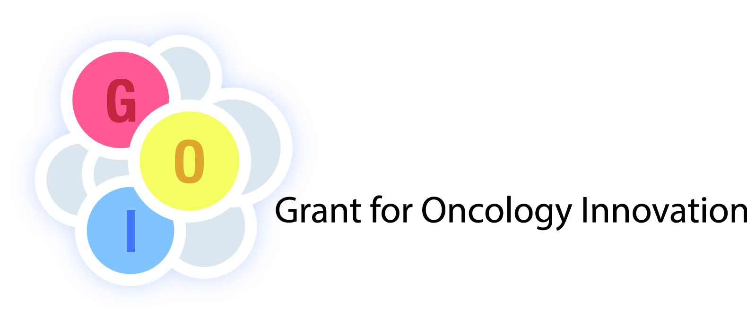
2015

Slide 2
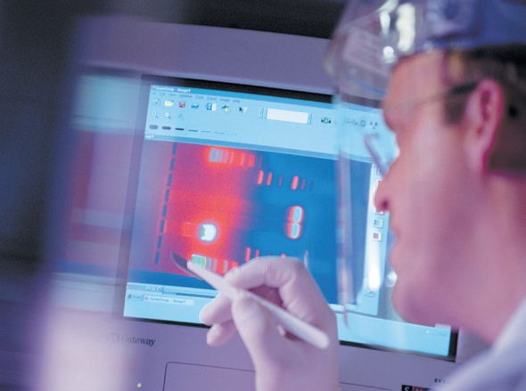
The Grant for Oncology Innovation (GOI)
The GOI is an initiative funded by Merck Serono to identify and support innovative projects that have the potential to advance research on personalized treatment for solid tumours
The grant programm was launched to coincide with the European Cancer Congress (ECCO-ESMO-ESTRO) in Amsterdam, September-October, 2013.
Applications for the 2015 GOI award are now open.
Should you wish to apply for the grant, please send a short message to:
goi@merckgroup.com

Slide 3
The Grant for Oncology Innovation (GOI)
A total grant of up to €1,000,000 will be awarded to one or more selected projects
The 2015 grant is open for applications following ECCO-ESMO-ESTRO 2014 and will close on 30 January 2015.

Slide 4
GOI assessment criteria
Applications will be evaluated by a Scientific Steering Committee, including internationally renowned oncologists and researchers, according to the following criteria:
  relevance to patient care
  innovative approach
  scientific impact
  feasibility
  relevance for the personalization of treatment

Slide 5
Areas of interest for the GOI
Areas of particular interest include:
  access to personalized treatment/care for patients
  innovative research with clinical relevance and benefits for patients
  solid tumour malignancies
Potential research topics that could be funded through the GOI include:
  research on molecular biomarkers or new targeted treatments
  technology platforms for the routine analysis of molecular biomarkers, side effect management
  platforms or tools that allow patients to access individualized treatment

Slide 6
How to apply
If you have any queries or wish to pre-register your interest for the 2015 grant please send your enquiries to: goi@merckgroup.com
Application process for the 2015 grant (opens after ESMO 2014):
Visit: www.grantforoncologyinnovation.org
Application deadline: 31 January 2015

Slide 7
How to apply
Step 1: Applicants should send an e-mail expressing their interest to goi@merckgroup.com. They will then receive an automatic reply inviting them to complete a letter of intent and provide a brief description of their research project, including supportive data.
Step 2: Applicants should submit their completed letter of intent and details of their project to goi@merckgroup.com. In response they will receive an acknowledgement of the completion of their submission, which concludes the initial application process.
If the applicant does not receive a request to complete the letter of intent or an acknowledgement of the completion of the initial application process ('Thank You' message), they must assume that their application has not been received by the innovation grant administrator, and should therefore resubmit their initial enquiry to goi@merckgroup.com.
.

Slide 8
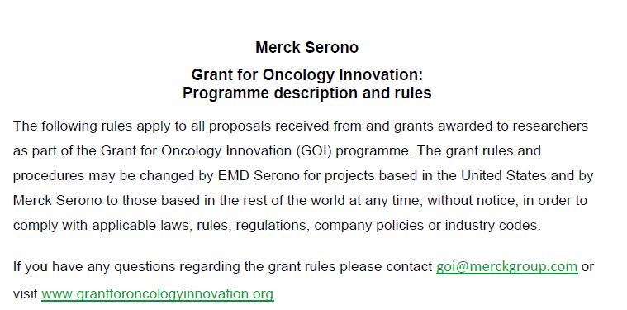
Programme description and rules

